Slide 1
SYSTEM PROGRAMMING LECTURE
Lecturer Izazullah
GPGC Charsadda

Slide 2
COFF
What is COFF?
The Common Object File Format (COFF) is a file format used to store executable, object code, and shared library files on Unix systems.
It's a standard format that specifies how information about programs and libraries is organized and stored.
COFF is associated with the Unix System v operating system and is often used with compilers and linkers on Unix-based systems.
The assembler and link step create object files in common object file format (COFF).
This format encourages modular programming and provides powerful and flexible methods for managing code segments and target system memory.

Slide 3
COFF
COFF File Structure:
The elements of a COFF object file describe the file's sections and symbolic debugging information. These elements include:
A file header
Optional header information
A table of section headers
Raw data for each initialized section
Relocation information for each initialized section
A symbol table
A string table

Slide 4
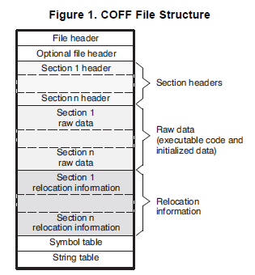
COFF
COFF File Structure

Slide 5
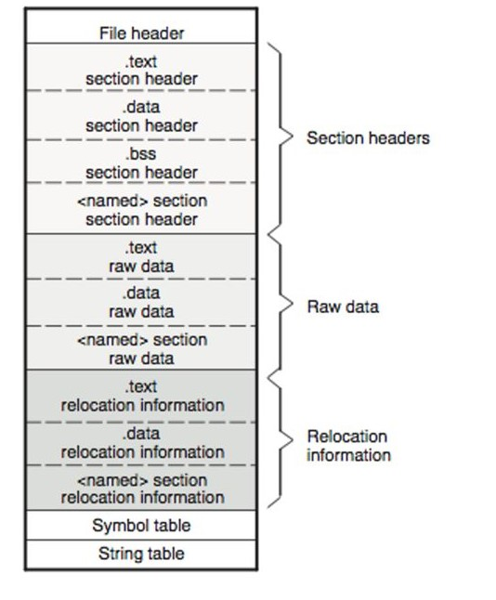
COFF
Figure 2

Slide 6
COFF
File Header Structure:
The file header contains 22 bytes of information that describe the general format of an object file.
File Header Contents
Byte Number Type Description
0-1 Unsigned short Version ID; indicates version of COFF file structure
2-3 Unsigned short Number of section headers
4-7 Integer Time and date stamp; indicates when the file was created
8-11 Integer File pointer; contains the symbol table's starting address
12-15 Integer Number of entries in the symbol table
16-17 Unsigned short Number of bytes in the optional header. This field is either 0
or 28; if it is 0, there is no optional file header.
18-19 Unsigned short Flags
20-21 Unsigned short Target ID; magic number.

Slide 7
COFF
Optional Header:
In some variants of the COFF format, an optional header may be present, providing additional information about the file, such as the size of the image, base address, and other operating system-specific details.
Table Optional File Header Contents
Byte Number Type Description
0-1 Short Optional file header magic number (0108h)
2-3 Short Version stamp
4-7 Long Size (in bytes) of executable code
8-11 Long Size (in bytes) of initialized data
12-15 Long Size (in bytes) of uninitialized data
16-19 Long Entry point
20-23 Long Beginning address of executable code
24-27 Long Beginning address of initialized data

Slide 8
COFF
Section Headers:
The header is followed by a table of section headers. Each section header describes a specific section of the file, such as code, data, or debug information. Sections can include .text for code, .data for initialized data, .bss for uninitialized data, and others.
Relocation Information:
COFF files may include relocation information that specifies how the addresses in the code and data sections should be adjusted during the linking process.
The assembler automatically generates relocation entries.
The link step reads the relocation entries as it reads each input section and performs relocation.
The relocation entries determine how references within each input section are treated.

Slide 9
COFF
Symbol Table:
COFF files contain a symbol table that keeps track of the symbols used in the code. Symbols can include variables, functions, and labels. Each symbol entry in the table provides information about the symbol's name, type, location, and other attributes.
The entry for each symbol in the symbol table contains the symbol's:
Name (or an offset into the string table)
Type
Value
Section it was defined in
Storage class
Static Variables ---------------------------------- . . . ---------------------------------- Defined Global Symbols. ---------------------------------- Undefined Global Symbols

Slide 10
COFF
String Table:
The symbol table often references a string table that contains the names of symbols.
Instead of embedding the names directly into the symbol table, which would waste space, the string table holds the names and is referred to by indices from the symbol table.

Slide 11
THANK YOU

